Slide 1
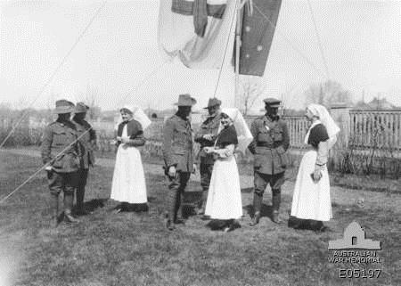
Role of Nurses in WWI
Student’s Name
Institutional Affiliation
Date

Slide 2
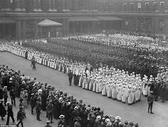
Introduction
Nurses played a very important role during WWI
The WWI witnessed nurses from different nations including the Great Britain, America, and Australia who either volunteered or were chosen to provide medical care to their respective soldiers.
The American Army Nurse Corps comprised of around 403 nurses who were actively involved in war and around 170 nurses in their reserves.
Approximately 3,000 Australian civilian nurses volunteered to serve during WWI, over 2,200 of them served overseas while more than 400 served in Australia (Sutherland, 2016).

Slide 3
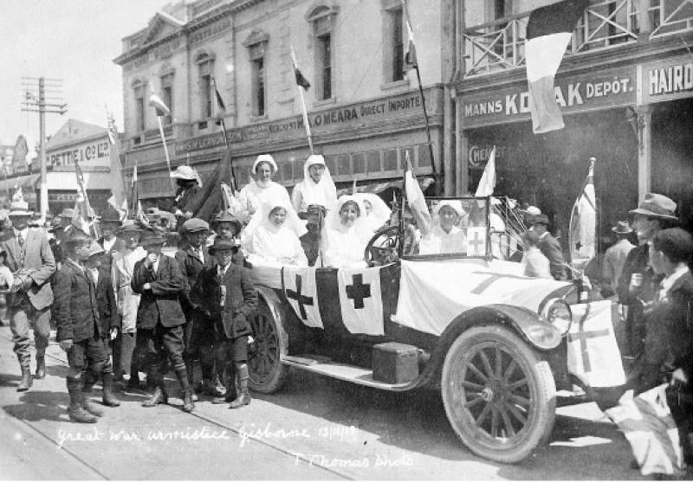
Duties on the front lines
Nurses during WWI were bold enough to take on frontline duties during the onset of war
The presence of nurses on the front lines served the soldier’s medical force and also provided emotional care to them.
Nurses conducted treatments to affected soldiers at field hospitals that were either close to or just behind the front lines (Sutherland, 2016).
To increase their efficiency, some of them served during troop transport including transport ships while others even drove the military ambulances.

Slide 4
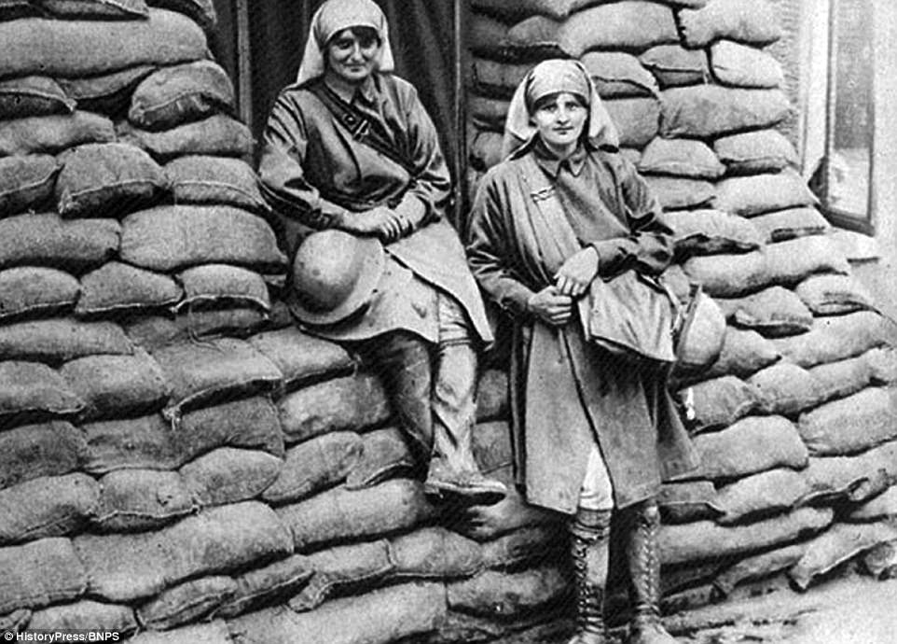
Duties on the front lines cont’d…
The nurses served by treating several types of wounds, mustard gas burns, and infections.
Other nurses were trained to serve in the field of social work which included psychiatric training that helped current soldiers and those returning home to deal with the war experiences (Sutherland, 2016).
The positions occupied by the nurses included nursing aides, dieticians, and physicians.
Other nurses occupied regular positions in hospitals while others served in natural disaster and emergency fields.

Slide 5
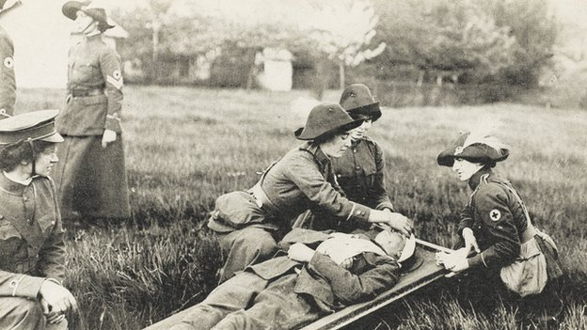
Changes in Care
Nurses were also responsible for implementing changes in healthcare by taking part in more advanced practices to carter for the needs of the soldiers.
Cleanliness and its relation to reduced infections was implemented and it served a great deal in saving lives since infections were rampant among soldiers in the field compared to those in hospitals (O'Sullivan, 2015).
The nurses also had to adapt to trench warfare approach and the infections that came with it as they had to regularly treat soldiers with “trench fever” and conditions like “trench foot” that resulted in the swelling of the feet due to coldness.

Slide 6
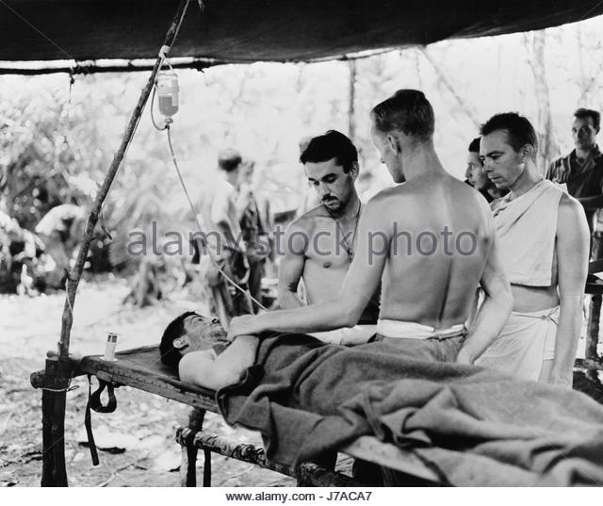
Changes in Care Cont’d…
The nurses during this war period had to employ the use of blood transfusions which was a relatively new resource then, to save the lives of most soldiers who lost a lot of blood from injuries (O'Sullivan, 2015).
Nurses also had to use the triage facet to determine the urgency of medication needs among the soldiers and the effective way of responding to them. This also saved a lot of lives.

Slide 7
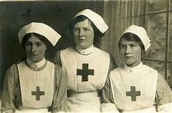
Red Cross Military Services
Most nurses were also recruited in Red Cross military services where they were assigned different tasks in different regions.
In the U.S., more than 23,000 nurses were enrolled by the Red Cross country’s Red Cross organization during WWI (Cotter, C018).
More than 19,000 nurses of those recruited were given active duties with the country’s Navy, Army, and Public Health Services.

Slide 8
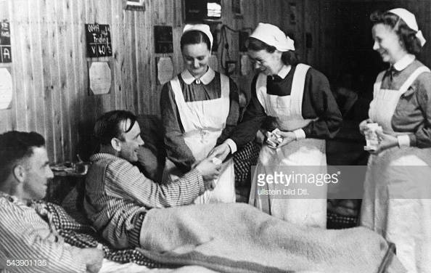
Red Cross Military Services Cont’d…
The nurses served in the convalescent homes and hospitals that the Red Cross had established (Cotter, 2018).
They directly dealt with administration of medicine and could run the daily functions of the hospitals.
To relieve the soldiers from the war experience, the nurses also held dances and showed movies to the soldiers.

Slide 9
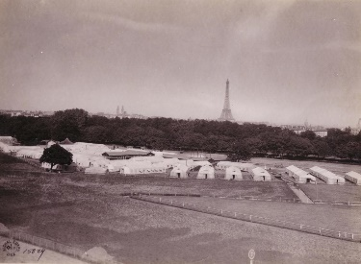
American Nurses in France
The U.S. Army Nurse Corps provided many services to casualties from different nations during WWI.
In France, American nurses served within the six British Expeditionary Forces hospitals and an additional nine base hospitals (Army Nurse Corps Association, 2014).
In the process the nurses had to acclimate to both the British Army was and the American Army way of providing medical care.
The nurses worked for 14-18 hours shifts and were ac countable for very many soldiers as the as the ratio was 70 nurses for every 5000 patients.
The figure on the right shows hospital no.2 at Auteuil, Paris. (Army Nurse Corps Association, 2014)

Slide 10
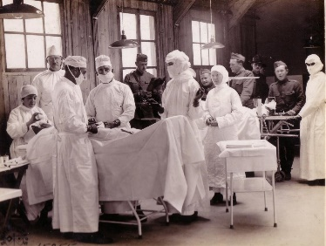
American Nurses in France Cont’d…
The American nurses in France employed their relevant experiences and skills that were necessary in the administering orthopedic work, anesthesia, and psychiatric nursing.
The nursing teams specialized in gas, shock, and orthopedic techniques and cold moved to the war’s front lines either in groups of five or six nurses (Army Nurse Corps Association, 2014).
Nursing shock teams could administer fluids and blood to critical patients while surgical teams performed chest and neurosurgical operations.

Slide 11
Conclusion
Nurses made a very significant impact during the WWI as they contributed in providing medical services to most of the casualties.
The Red Cross also enrolled numerous nurses who served in various regions during the war.
American Nurse Corps were also resourceful during this period as they provided different medical services to both their country and also collaborated with the British Army nurses in France.

Slide 12
References
Army Nurse Corps Association. (2014). ontributions of the U.S. Army Nurse Corps in World War I. Retrived from: https://e-anca.org/History/Topics-in-ANC-History/Contributions-of-the-US-Army-Nurse-Corps-in-WWI
Cotter, C. (2018). Red Cross. International Encyclopedia of the First World War, 10.
O'Sullivan, B. (2015). The forgotten'sisters' of WW1. Kai Tiaki: Nursing New Zealand, 21(11), 34.
Sutherland-Fraser, S. (2016). Learning from history: Count backwards from 100: Nurse anaesthetists during WWI. ACORN: The Journal of Perioperative Nursing in Australia, 29(3), 39.

